Slide 1
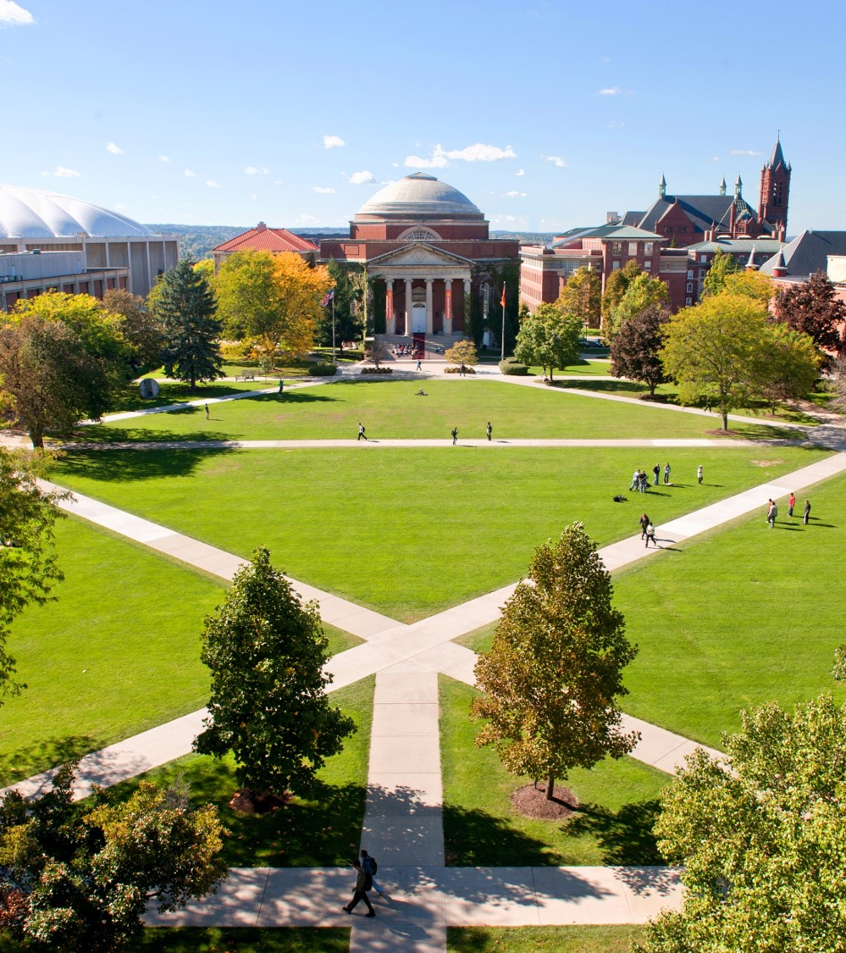
Applied Data Science Portfolio Presentation5
Brian Taylor
SUID# 251968713
rtaylo11@syr.edu
https://github.com/rtaylo11/SU_Portfolio

Slide 2
Agenda
Introduction
Project 1 – IST 659 – Youth basketball performance evaluations
Project 2 – IST 707 – Trending YouTube Videos
Project 3 – IST 652 – U.S. National Disasters of the past 64 Years
Project 4 – IST 736 – Text Mining for the Ultimate Fantasy Football Team
Project 5 – IST 719 – Crime Visualization
Conclusion

Slide 3
Introduction
R. Brian Taylor
20 years military service, retiring Operations Research and Systems Analyst
Started ADS program in 2018
Demonstrate ability in the following:
Describe a broad overview of the major practice areas in data science.
Collect and organize data.
Identify patterns in data via visualization, statistical analysis, and data mining.
Develop alternative strategies based on the data.
Develop a plan of action to implement the business decisions derived from the analysis.
Demonstrate communication skills regarding data and its analysis for managers, IT professionals, programmers, statisticians, and other relevant professionals in their organization.
Synthesize the ethical dimensions of data science practice (e.g., privacy).

Slide 4
Project 1 – IST 659 Youth basketball performance evaluations

Slide 5
Project 2 – IST 707 Trending YouTube Videos

Slide 6
Project 3 – IST 652 U.S. National Disasters of the past 64 Years

Slide 7
Project 4 – IST 736 Text Mining for the Ultimate Fantasy Football Team

Slide 8
Project 4 – IST 736 Text Mining for the Ultimate Fantasy Football Team

Slide 9
Project 5 – IST 719 Crime Visualization

Slide 10
Project 5 – IST 719 Crime Visualization

Slide 11
Conclusion
Demonstrated Achievement of Learning Goals
Describe a broad overview of the major practice areas in data science.
Collect and organize data.
Identify patterns in data via visualization, statistical analysis, and data mining.
Develop alternative strategies based on the data.
Develop a plan of action to implement the business decisions derived from the analysis.
Demonstrate communication skills regarding data and its analysis for managers, IT professionals, programmers, statisticians, and other relevant professionals in their organization.
Synthesize the ethical dimensions of data science practice (e.g., privacy).

Slide 12
Thank You3
Brian Taylor
SUID# 251968713
rtaylo11@syr.edu
https://github.com/rtaylo11/SU_Portfolio

